Slide 1
Artificial Intelligence 501
Lesson 7
Hardware

Slide 2
Legal notices & disclaimers
This document contains information on products, services and/or processes in development. All information provided here is subject to change without notice. Contact your Intel representative to obtain the latest forecast, schedule, specifications and roadmaps.
Intel technologies’ features and benefits depend on system configuration and may require enabled hardware, software or service activation. Learn more at intel.com, or from the OEM or retailer. No computer system can be absolutely secure.
Tests document performance of components on a particular test, in specific systems. Differences in hardware, software, or configuration will affect actual performance. Consult other sources of information to evaluate performance as you consider your purchase. For more complete information about performance and benchmark results, visit http://www.intel.com/performance.
Cost reduction scenarios described are intended as examples of how a given Intel-based product, in the specified circumstances and configurations, may affect future costs and provide cost savings. Circumstances will vary. Intel does not guarantee any costs or cost reduction.
Statements in this document that refer to Intel’s plans and expectations for the quarter, the year, and the future, are forward-looking statements that involve a number of risks and uncertainties. A detailed discussion of the factors that could affect Intel’s results and plans is included in Intel’s SEC filings, including the annual report on Form 10-K.
The products described may contain design defects or errors known as errata which may cause the product to deviate from published specifications. Current characterized errata are available on request.
Performance estimates were obtained prior to implementation of recent software patches and firmware updates intended to address exploits referred to as "Spectre" and "Meltdown." Implementation of these updates may make these results inapplicable to your device or system.
No license (express or implied, by estoppel or otherwise) to any intellectual property rights is granted by this document.
Intel does not control or audit third-party benchmark data or the web sites referenced in this document. You should visit the referenced web site and confirm whether referenced data are accurate.
Intel, the Intel logo, Pentium, Celeron, Atom, Core, Xeon and others are trademarks of Intel Corporation in the U.S. and/or other countries. *Other names and brands may be claimed as the property of others.
© 2018 Intel Corporation.

Slide 3
Learning Objectives
You will be able to:
Define “datacenter”, “gateway”, and ”edge computing”
Recall the key processor types for AI
Explain how Intel® hardware applies to AI
Compare Central (CPU) and Graphic (GPU) processing units
Describe Field Programmable Gate Arrays (FPGA)

Slide 4
AI in the Modern Era
Faster hardware is one of the key areas driving the modern era of AI.
Faster Computers
Bigger datasets
Neural Nets
Cutting Edge Results in a Variety of Fields
Notes:
Haven’t we heard the promise of AI before—as early as the 1960s, and again in the 1980s, when a lot of research went into AI? Yes, but the timing wasn’t right back then, and 3 things have brought AI to life today:
Compute breakthrough: Paved by Moore’s Law, compute capability and architectural innovation have progressed to the point where we’ve crossed the threshold required to support the intense demands of machine intelligence. For example, the concept of deep learning through artificial neural networks has existed for at least 20 years, but not until the past few years have computing advancements enabled the practical application of these intensive algorithms, thanks to greater accuracy and speed.
Data deluge: Our world of smart and connected devices has unleashed a data deluge, as the Internet of Things (IoT) joins apps in generating continuous streams of structured and unstructured data. The IoT will include a projected 200 billion smart-and-connected devices by 2020,⁸ and the data produced is expected to double every two years to total 40 zettabytes (40 trillion gigabytes) by 2020. These vast data stores are required to train many AI algorithms and are ripe to be mined for fresh insights.
Innovation surge: Of course, compute power and data are not enough on their own. The road to AI is also being driven by a surge of innovation that has pushed us over the tipping point from research to mainstream use. Each new AI algorithmic innovation and use case opens more eyes to the power of AI, leading more innovators to join the community and stimulating an ever-increasing demand for the technology. Neural network innovations in the 1990s renewed research into AI, but it was accuracy breakthroughs in both speech recognition and image recognition, in 2009 and 2012 respectively, that proved to be catalysts for today’s surge of innovation. In last year’s ImageNet Computer Vision contest, a neural network–based application even outperformed a human. As we progress, a plethora of unsolved AI challenges will continue to attract researchers and innovators around the world.

Slide 5









Intel® AI Portfolio
Experiences
Notes:
Intel has the full stack of end to end AI products for building AI solutions at enterprise scale.
We’ve covered hardware up to this point, but software is critical to unleashing the full compute potential.
Now we’ll cover libraries and frameworks
At the lowest level, Intel optimized primitive functions that are used across a wide array of machine & deep learning frameworks and solutions, including the Math Kernel Library (MKL), Data Analytics Acceleration Library (DAAL), and Intel Python distribution.
At the framework level, Intel is committed to optimizing the most popular analytics, machine & deep learning frameworks by the end of 2016. As far as tools, Intel offers the Deep Learning SDK to accelerate deep learning training & deployment, the Saffron Natural Intelligence Platform for reasoning systems, and we are a key contributor to the Trusted Analytics Platform for classic machine learning and data analytics.

Slide 6
Intel® AI Portfolio
Platforms
Intel® Deep Learning Studio
Intel® Saffron™
Intel® Computer Vision SDK
Intel® Movidius™ MDK
Intel® Deep Learning Cloud & Appliance
Notes:
Intel has the full stack of end to end AI products for building AI solutions at enterprise scale.
We’ve covered hardware up to this point, but software is critical to unleashing the full compute potential.
Now we’ll cover libraries and frameworks
At the lowest level, Intel optimized primitive functions that are used across a wide array of machine & deep learning frameworks and solutions, including the Math Kernel Library (MKL), Data Analytics Acceleration Library (DAAL), and Intel Python distribution.
At the framework level, Intel is committed to optimizing the most popular analytics, machine & deep learning frameworks by the end of 2016. As far as tools, Intel offers the Deep Learning SDK to accelerate deep learning training & deployment, the Saffron Natural Intelligence Platform for reasoning systems, and we are a key contributor to the Trusted Analytics Platform for classic machine learning and data analytics.

Slide 7








Intel® AI Portfolio
Frameworks
Mllib BigDL
Notes:
Intel has the full stack of end to end AI products for building AI solutions at enterprise scale.
We’ve covered hardware up to this point, but software is critical to unleashing the full compute potential.
Now we’ll cover libraries and frameworks
At the lowest level, Intel optimized primitive functions that are used across a wide array of machine & deep learning frameworks and solutions, including the Math Kernel Library (MKL), Data Analytics Acceleration Library (DAAL), and Intel Python distribution.
At the framework level, Intel is committed to optimizing the most popular analytics, machine & deep learning frameworks by the end of 2016. As far as tools, Intel offers the Deep Learning SDK to accelerate deep learning training & deployment, the Saffron Natural Intelligence Platform for reasoning systems, and we are a key contributor to the Trusted Analytics Platform for classic machine learning and data analytics.

Slide 8

Intel® AI Portfolio
Libraries
Intel® Data Analytics Acceleration Library (Intel® DAAL)
Intel® Math Kernel Library (Intel® MKL, MKL-DNN)
Intel® Distribution for Python*
(Performance Optimized)
Intel® nGraph™ Library
*Other names and brands may be claimed as the property of others.
Notes:
Intel has the full stack of end to end AI products for building AI solutions at enterprise scale.
We’ve covered hardware up to this point, but software is critical to unleashing the full compute potential.
Now we’ll cover libraries and frameworks
At the lowest level, Intel optimized primitive functions that are used across a wide array of machine & deep learning frameworks and solutions, including the Math Kernel Library (MKL), Data Analytics Acceleration Library (DAAL), and Intel Python distribution.
At the framework level, Intel is committed to optimizing the most popular analytics, machine & deep learning frameworks by the end of 2016. As far as tools, Intel offers the Deep Learning SDK to accelerate deep learning training & deployment, the Saffron Natural Intelligence Platform for reasoning systems, and we are a key contributor to the Trusted Analytics Platform for classic machine learning and data analytics.

Slide 9
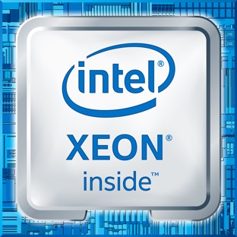
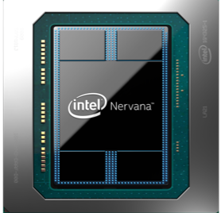
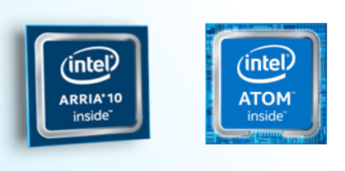
Intel® AI Portfolio
Hardware
Notes:
Intel has the full stack of end to end AI products for building AI solutions at enterprise scale.
We’ve covered hardware up to this point, but software is critical to unleashing the full compute potential.
Now we’ll cover libraries and frameworks
At the lowest level, Intel optimized primitive functions that are used across a wide array of machine & deep learning frameworks and solutions, including the Math Kernel Library (MKL), Data Analytics Acceleration Library (DAAL), and Intel Python distribution.
At the framework level, Intel is committed to optimizing the most popular analytics, machine & deep learning frameworks by the end of 2016. As far as tools, Intel offers the Deep Learning SDK to accelerate deep learning training & deployment, the Saffron Natural Intelligence Platform for reasoning systems, and we are a key contributor to the Trusted Analytics Platform for classic machine learning and data analytics.

Slide 10
End - to - End AI Computing

Slide 11


End-to-End Computing for AI
Many-to-many hyperscale,
for stream and massive batch data processing
Datacenter
Ethernet & Wireless
1-to-many,
majority streaming data from devices
gateway
Wireless & non-IP wired,
secure, high throughput, real-time
1-to-1 devices,
lower power and UX requirements
Edge
Notes:
Intel’s end-to-end hardware portfolio spans the datacenter, gateway and edge. Some compute engines span the entire spectrum, while others are tailored specifically for one or two kind of applications. In the coming slides, we’ll explore the positioning of each product in this broad portfolio, first for the datacenter, then for the gateway & edge.
The same types of operations that are done for training must also be done for inference. In fact, as we’ve explained, training involves inference! So you could certainly use a processor designed for training to do inference. However, the use cases of training and inference are not the same, which often implies different processor requirements.
With training, you want to run through a large number of computations on the order of exaflops (a billion billion operations!) as fast as possible, all at once. Training is typically done in a data center, where processor power and physical size are less of a constraint.
Inference, on the other hand, must happen over and over again as the trained model is in use over some extended period of time. There may be strict size or power constraints – for example if the inference is happening in a smartphone or a self-driving car.
So while you could use the same processor for inference as you do for training, sometimes using alternate designs is a more optimal approach for a given use case.

Slide 12
End-to-End Computing for AI
There are various hardware requirements for different AI tasks.
AI tasks can include data collection and fusion, training, and inference.
The number of operations for training can be on the order of exaFLOPS, making this task more suited for datacenters.
Inference takes fewer operations than training and can be done on both edge devices and at datacenters.
Certain applications can have constraints on the processor size and power. For example, wearable devices and drones.
Notes:
Intel’s end-to-end hardware portfolio spans the datacenter, gateway and edge. Some compute engines span the entire spectrum, while others are tailored specifically for one or two kind of applications. In the coming slides, we’ll explore the positioning of each product in this broad portfolio, first for the datacenter, then for the gateway & edge.
The same types of operations that are done for training must also be done for inference. In fact, as we’ve explained, training involves inference! So you could certainly use a processor designed for training to do inference. However, the use cases of training and inference are not the same, which often implies different processor requirements.
With training, you want to run through a large number of computations on the order of exaflops (a billion billion operations!) as fast as possible, all at once. Training is typically done in a data center, where processor power and physical size are less of a constraint.
Inference, on the other hand, must happen over and over again as the trained model is in use over some extended period of time. There may be strict size or power constraints – for example if the inference is happening in a smartphone or a self-driving car.
So while you could use the same processor for inference as you do for training, sometimes using alternate designs is a more optimal approach for a given use case.

Slide 13
Datacenter
Datacenters are used to store and process data for applications, from websites to Internet of Things (IoT) systems.
Low latency, high bandwidth – needed to access high compute resources.
Reliability, lack of downtime, high performance.
AI is the fastest-growing datacenter workload.
A ~12X growth in demand by 2020 is expected.
Training is typically done in a datacenter, allowing high processor power and physical size.
Datacenter
Notes:
What is Intel’s forecast for this market?
While only 7% of server sales in 2016 were used for artificial intelligence workloads, it is the fastest-growing data center workload, and we foresee ~12X growth in demand by 2020 in the datacenter alone, not to mention significant usage in edge devices (cars, phones, cameras etc.).
Within that 7% last year, 60% of servers were used for ‘conventional machine learning’ while the remaining 40% were used for ‘deep learning’.
Among servers used for conventional machine learning, 97% used Intel Xeon processors to handle the computations, 2% used other architectures, and 1% used Intel processors paired with GPUs.
Among servers used for deep learning, 91% use just Intel Xeon processors to handle the computations, 7% use Intel Xeon processors paired with GPUs, and 2% use other architectures altogether.

Slide 14
Gateway
Gateway computers route information from edge devices into and out of datacenters.
High bandwidth – able to handle input from many devices and route correctly.
Lightweight protocols – can’t require extensive CPU usage, keeping gateway computer fast.
Secure protocols – gateway computers are often a security point of failure.
Sensors
Gateway
Datacenter
Edge
Notes:
https://en.wikipedia.org/wiki/Gateway_(telecommunications)

Slide 15
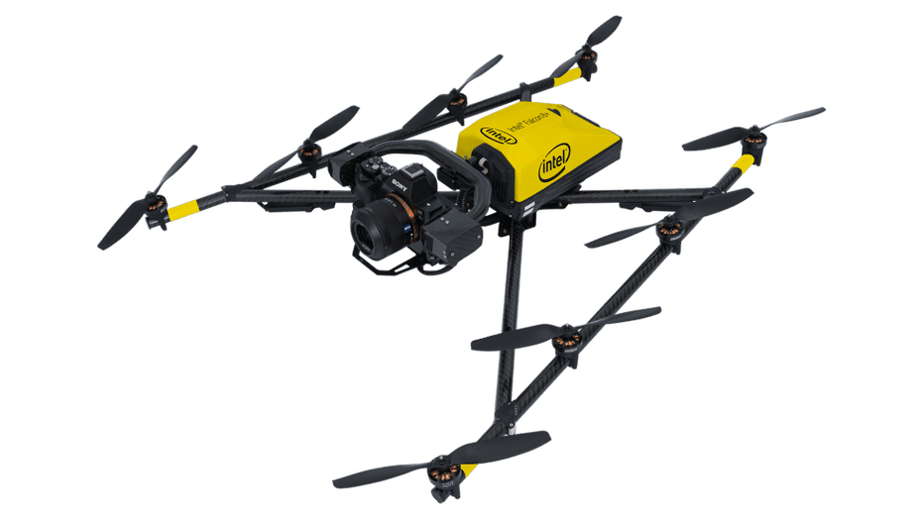
Edge
Edge computing refers to computing happening as close as possible to where the computation is required.
Sensors read information and compute a result directly on an IoT device, without sending information to data center.
Reduces communication between sensors and datacenter.
Uses resources that are not continuously connected to a network.
Edge computing often used for inference rather than model training.
Notes:
Real world examples: drone navigation or windmill adjustment, based on on-device sensors

Slide 16
End-to-End Example: Automated Driving
Autonomous vehicles produce ~4 terabytes of data per day.
One car, driving for one hour, requires ~5 exaFLOPS of computational power in order to safely keep it on the road.
DARPA Self-Driving Car Challenge Won in 2005
Notes:
Perhaps the best example of Intel’s comprehensive AI strategy in action is automated driving. Data produced by autonomous vehicles is immense, on the order of 4 Terabytes of data per day. Compute required for autonomous vehicles is even more astounding, with 1 car driving for 1 hour requiring on the order of 5 ExaFLOPs of compute to safely keep it on the road. So it’s clear that performance and world class data management are two important pillars… but that’s not enough. A holistic AI portfolio is also crucial, because in automated driving, as in so many other industries, many disparate systems and capabilities must work seamlessly together in order to deliver a safer and more enjoyable commute. Intel has an unmatched portfolio of AI technologies, from car to cloud, and we are applying them to deliver the most scalable and secure platform for automated driving, enabling industry innovators to build rapidly and pursue countless design iterations across brands and fleets.

Slide 17
End-to-End Example: Automated Driving
Vehicle requires:
Human-Machine Interface (HMI) – to build trust between driver and vehicle and provide advanced virtualization and graphics capabilities
Scalable, powerful in-vehicle computing
Sensor processing
Environment modeling
Driving functions
Car
Notes:
Scalable, powerful in-vehicle computing
Fulfill the widest range of market needs with scalable architecture for in-vehicle computing. Intel delivers an incredibly high performance per watt with plenty of headroom to grow for ADAS and the software-defined cockpit. Intel® silicon and software support better human-machine interface (HMI) designs that build trust between driver and vehicle and provide advanced virtualization and graphics capabilities.

Slide 18
End-to-End Example: Automated Driving
Network requires:
Vehicle-to-vehicle (V2V) and Vehicle-to-everything (V2X) communication
Next-generation network connectivity
Over-the-air-updates
High-definition maps
Network
Notes:
Next-generation network connectivity
Be prepared to harness the next generation of connectivity for over-the-air updates, high-definition maps, and vehicle-to-vehicle (V2V) and vehicle-to-everything (V2X) communication. Intel’s automotive-grade wireless communications solutions support today’s state-of-the-art technology, while paving a path toward future 5G solutions.

Slide 19
End-to-End Example: Automated Driving
Datacenter requires:
High-performance data center and cloud
AI to fleet management to data mining
Model training
Greater than real time inference
Datacenter
Notes:
High-performance data center and cloud
Ensure a high-performance data center with cloud capabilities that meets the demands of the new transportation value chain, from artificial intelligence (AI) to fleet management to data mining. Intel® Data Center technologies can scale to meet the demands of a range of data analytics workloads while accelerating the time to train deep learning models for AI—both key for highly and fully autonomous driving.

Slide 20
Datacenter AI

Slide 21
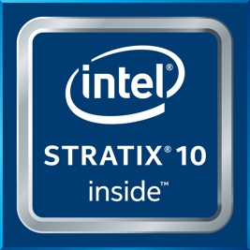
Datacenter AI
Intel® offers a range of processors to compute in the datacenter.
Intel® hardware at the datacenter:
Field-programmable gate array (FPGA): spectrum of datacenter to edge.
Intel® Xeon® processors: widest variety of AI and other data center workloads
Intel® Nervana™ Neural Network Processor: custom built processor
Intel® Stratix® 10 FPGA
Intel® Xeon® Processors
Intel® Nervana™
Notes:
Intel’s end-to-end hardware portfolio spans the datacenter, gateway and edge. Some compute engines span the entire spectrum, while others are tailored specifically for one or two kind of applications. In the coming slides, we’ll explore the positioning of each product in this broad portfolio, first for the datacenter, then for the gateway & edge.
AI remains a small but fastest growing workload in the datacenter. Comprised primarily of classic machine learning and deep learning, the share of deep learning is also growing. Intel architecture-based servers are used in nearly all classic machine learning deployments, and in the vast majority of deep learning. GPUs are used as accelerators for deep learning, in particular training, although Intel now has targeted accelerators of our own for both training and inference to compete with GPUs.
Building on the Intel® Xeon® processor, with its scalable performance for wide variety of AI, deep learning and other datacenter workloads, Intel’s portfolio also includes more targeted accelerators. For more intensive deep learning environments, the Intel® Nervana™ Neural Network Processor (formerly codenamed Crest family) will deliver the best scalable performance acceleration, and Intel® FPGA technology delivers scalable acceleration for wide variety of AI and other workloads & configurations including novel apps.
*Future product that was formerly codenamed the “Crest family”
All performance positioning claims are relative to other processor technologies in Intel’s AI datacenter portfolio
All products, computer systems, dates, and figures specified are preliminary based on current expectations, and are subject to change without notice.

Slide 22
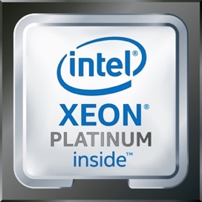
Intel® Xeon® Scalable Processor Family
Notes:
Before we look at AI product positioning in the datacenter, let’s first look at the workhorse in the datacenter. The Intel® Xeon® processor is an excellent choice to begin your AI journey, with potent performance for all types of AI, including deep learning thanks to Intel’s optimization of the most popular open-source deep learning frameworks.
Built-in ROI: Begin your AI journey today using existing, familiar infrastructure
Increase datacenter utilization without additional, unique investment
Use common AI frameworks and/or BigDL for scale deep learning training on Spark Hadoop
Potent Performance: Up to 113X deep learning perf gains via Intel SW optimizations in past year
Intel’s optimizations for popular deep learning frameworks (e.g. Caffe, TensorFlow, Theano, Torch, etc) have produced enormous performance gains in the past year; the most popular frameworks are now able to get the most out of the CPU!
Production-Ready: Robust support for full range of AI deployments
Runs all combinations of AI workloads:
Classic ML
Deep Learning
Reasoning
Emerging AI
Analytics
More
Server-class reliability, hardware enhanced security and manageability

Slide 23
Intel® Xeon® Scalable Processor Family
Scalable performance for widest variety of AI, datacenter workloads, and DL.
Can use existing general-purpose Intel® Xeon® processor clusters for DL training and inference, classical ML, and big data workloads.
Popular AI frameworks such as TensorFlow* and MXNet* have been optimized for Intel architecture
BigDL for scale deep learning training on Spark Hadoop*.
Production-ready robust support for full range of AI deployments.
*Other names and brands may be claimed as the property of others.
Notes:
Before we look at AI product positioning in the datacenter, let’s first look at the workhorse in the datacenter. The Intel® Xeon® processor is an excellent choice to begin your AI journey, with potent performance for all types of AI, including deep learning thanks to Intel’s optimization of the most popular open-source deep learning frameworks.
Built-in ROI: Begin your AI journey today using existing, familiar infrastructure
Increase datacenter utilization without additional, unique investment
Use common AI frameworks and/or BigDL for scale deep learning training on Spark Hadoop
Potent Performance: Up to 113X deep learning perf gains via Intel SW optimizations in past year
Intel’s optimizations for popular deep learning frameworks (e.g. Caffe, TensorFlow, Theano, Torch, etc) have produced enormous performance gains in the past year; the most popular frameworks are now able to get the most out of the CPU!
Production-Ready: Robust support for full range of AI deployments
Runs all combinations of AI workloads:
Classic ML
Deep Learning
Reasoning
Emerging AI
Analytics
More
Server-class reliability, hardware enhanced security and manageability

Slide 24
Intel® Xeon® Scalable Processor Family
Intel® Xeon® processors power the vast majority of general purpose ML and inference workloads for businesses today.
Reduced time-to-train by using more server nodes scaling near linearly to hundreds of nodes.
On November 7, 2017 researchers published record training time results for both ResNet-50 and AlexNet* using Intel Xeon scalable processors and achieved state-of-the-art accuracy.
When combined with Intel® Math Kernel Library (Intel® MKL), 100x speedup in Deep Neural Net processing.
*Other names and brands may be claimed as the property of others.
Notes:
https://software.intel.com/en-us/articles/intel-processors-for-deep-learning-training
1. Y. You, et al., “ImageNet training in minutes.” Nov. 2017. https://arxiv.org/pdf/1709.05011.pdf

Slide 25
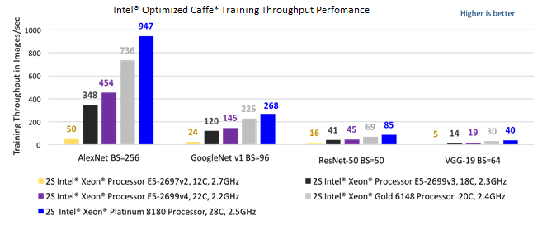
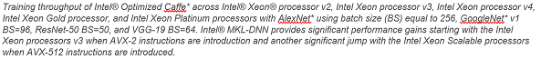
Intel® Xeon® Scalable Processor Family
*Other names and brands may be claimed as the property of others.
Notes:
https://software.intel.com/en-us/articles/intel-processors-for-deep-learning-training
1. Y. You, et al., “ImageNet training in minutes.” Nov. 2017. https://arxiv.org/pdf/1709.05011.pdf
Two 512-bit FMA units computing in parallel per core are available in Intel Xeon Platinum processors, Intel Xeon Gold processors 6000 series and 5122. Other Intel Xeon Scalable processor SKUs have one FMA unit per core.
The raw compute can be calculated as AVX-512-frequency * number-of-cores * number-of-FMAs-per-core * 2-operations-per-FMA * SIMD-vector-length / number-of-bits-in-numerical-format. The Intel Xeon Platinum 8180 has AVX-512-frequency * 28 * 2 * 2 * 512/32 = 1792 * AVX-512-frequency peak TFLOPS. The AVX-512 frequencies for multiple SKUs can be found at https://www.intel.com/content/www/us/en/processors/xeon/scalable/xeon-scalable-spec-update.html. The frequencies shown correspond to FP64 operations; the frequencies for FP32 may be slightly higher than the ones shown. The AVX-512 max turbo-frequency may not be fully sustained when running very high FLOPS workloads.
When executing in 512-bit register port scheme on processors with two FMA unit, Port 0 FMA has a latency of 4 cycles, and Port 5 FMA has a latency of 6 cycles. Bypass can have a -2 (fast bypass) to +1 cycle delay. The FMA unit supports fast bypass when all instruction sources come from the FMA unit. The instructions used for deep learning workloads at fp32 support bypass and have a latency of 4 cycles for both ports 0 and 5; see https://software.intel.com/sites/default/files/managed/9e/bc/64-ia-32-architectures-optimization-manual.pdf Section 15.17. An Intel Xeon Scalable processor with 2 FMAs requires at least 8 registers to hide these latencies for the data and the weights.
This does not work as we approach large batch sizes 8K+ [23]. After 8K, the learning rate should increase proportional to the square root of the increased in batch sizes.
The researchers added some modifications that will be committed to the main Intel Optimized Caffe branch.

Slide 26
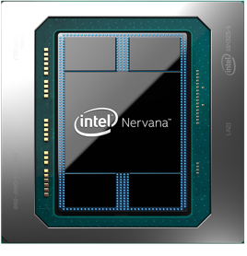
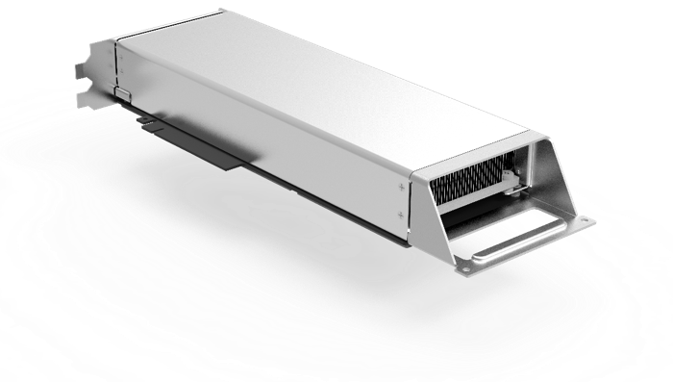
Intel® Nervana™ Neural Network Processor (NNP)
Notes:
See slide; for more detail see:
https://www.intelnervana.com/intel-nervana-neural-network-processors-nnp-redefine-ai-silicon/
AND
https://www.intelnervana.com/nervana-engine-delivers-deep-learning-at-ludicrous-speed/

Slide 27
Intel® Nervana™ Neural Network Processor (NNP)
The Intel® Nervana™ neural network processor (NNP) is a custom-designed chip for modern AI.
New memory management system and chip architecture optimized for DL utilization.
New data format “Flexpoint” for DL.
Hardware increases potential for parallel computation.
Intel® in close collaboration with Facebook for development.
Provides the needed flexibility to support DL primitives while making core hardware components as efficient as possible.
Notes:
See slide; for more detail see:
https://www.intelnervana.com/intel-nervana-neural-network-processors-nnp-redefine-ai-silicon/
AND
https://www.intelnervana.com/nervana-engine-delivers-deep-learning-at-ludicrous-speed/

Slide 28
Edge/Gateway AI

Slide 29
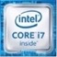

Edge-Specific Processors
Intel® offers a variety of edge computing-focused processors.
General Purpose Processors
Specific Use Processors
Intel® Atom® and Core™
Intel® processor graphics
Intel® Movidius™ VPU
Vision
Notes:
Intel’s end-to-end hardware portfolio spans the datacenter, gateway and edge. Some compute engines span the entire spectrum, while others are tailored specifically for one or two kind of applications. In the coming slides, we’ll explore the positioning of each product in this broad portfolio, first for the datacenter, then for the gateway & edge.
Intel is the only technology provider with a range of solutions for AI at the edge to meet each customer’s unique requirements, from most general purpose (left) to most targeted/narrow acceleration (right).
Atom/Core/Xeon: can handle a variety of workloads including basic DL inference and classic ML within a larger application
Intel Processor Graphics such as Iris, Iris Pro and HD graphics are good for a higher inference throughput and can also provide performance for media or graphics-intensive workloads that often come along with AI workloads
The Movidius Myriad family provides low power engine for computer vision workloads where deep learning low precision inference is needed
Finally the Gaussian Mixture Model and Neural Network Accelerator is for Low power, always on speech recognition IP block

Slide 30

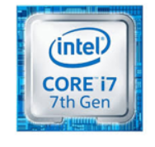
Intel® Atom® and Core™ Processors
Notes:
Intel is the only technology provider with a range of solutions for AI at the edge to meet each customer’s unique requirements, from most general purpose (left) to most targeted/narrow acceleration (right).
Atom/Core/Xeon: can handle a variety of workloads including basic DL inference and classic ML within a larger application
Intel Processor Graphics such as Iris, Iris Pro and HD graphics are good for a higher inference throughput and can also provide performance for media or graphics-intensive workloads that often come along with AI workloads
The Movidius Myriad family provides low power engine for computer vision workloads where deep learning low precision inference is needed
Finally the Gaussian Mixture Model and Neural Network Accelerator is for Low power, always on speech recognition IP block

Slide 31
Intel® Atom® and Core™ Processors
Intel® Atom® and Core™ processors are low power general purpose processors for embedded applications.
Lower power than Intel® Xeon® processors.
Can handle a variety of workloads including basic DL inference and classical ML within a larger application.
Widely used in Mobile Internet Devices (MIDs): feature-limited tablets.
Power edge computing in automobiles and other Internet of Things (IoT) applications.
Notes:
Intel is the only technology provider with a range of solutions for AI at the edge to meet each customer’s unique requirements, from most general purpose (left) to most targeted/narrow acceleration (right).
Atom/Core/Xeon: can handle a variety of workloads including basic DL inference and classic ML within a larger application
Intel Processor Graphics such as Iris, Iris Pro and HD graphics are good for a higher inference throughput and can also provide performance for media or graphics-intensive workloads that often come along with AI workloads
The Movidius Myriad family provides low power engine for computer vision workloads where deep learning low precision inference is needed
Finally the Gaussian Mixture Model and Neural Network Accelerator is for Low power, always on speech recognition IP block

Slide 32
Intel® Atom® and Core™ Processors
Amazon’s DeepLens* video camera uses the Intel® Atom® processor to run deep learning models locally for object detection and recognition. This can be used for face detection, activity recognition, and artistic style transfer.
*Other names and brands may be claimed as the property of others.
Notes:
DeepLens
https://newsroom.intel.com
http://linuxgizmos.com/amazon-spins-ubuntu-driven-aws-deeplens-cam-and-an-aws-savvy-amazon-freertos//news/deeplens-deep-learning-enabled-wireless-video-camera-powered-intel/
https://www.geekwire.com/2017/amazon-web-services-unveils-249-wireless-deep-learning-video-camera-developers/
https://aws.amazon.com/deeplens/

Slide 33
Intel® Iris Pro™ Graphics
Notes:
Intel® Quark™ processor.
Sensor and memory subsystems.
I/O interfaces.
Intel is the only technology provider with a range of solutions for AI at the edge to meet each customer’s unique requirements, from most general purpose (left) to most targeted/narrow acceleration (right).
Atom/Core/Xeon: can handle a variety of workloads including basic DL inference and classic ML within a larger application
Intel Processor Graphics such as Iris, Iris Pro and HD graphics are good for a higher inference throughput and can also provide performance for media or graphics-intensive workloads that often come along with AI workloads
The Movidius Myriad family provides low power engine for computer vision workloads where deep learning low precision inference is needed
Finally the Gaussian Mixture Model and Neural Network Accelerator is for Low power, always on speech recognition IP block

Slide 34
Intel® Iris Pro™ Graphics
The Intel® Iris Pro™ graphics chips are integrated graphics processors that sit on the same die as the CPU.
Widely used in laptops that do not have dedicated GPUs (e.g. most Apple laptops).
Architecture makes them well-suited for higher inference throughput, that is their most common use in AI.
Provide performance for media or graphics intensive workloads, that often are required for AI.
Notes:
Intel® Quark™ processor.
Sensor and memory subsystems.
I/O interfaces.
Intel is the only technology provider with a range of solutions for AI at the edge to meet each customer’s unique requirements, from most general purpose (left) to most targeted/narrow acceleration (right).
Atom/Core/Xeon: can handle a variety of workloads including basic DL inference and classic ML within a larger application
Intel Processor Graphics such as Iris, Iris Pro and HD graphics are good for a higher inference throughput and can also provide performance for media or graphics-intensive workloads that often come along with AI workloads
The Movidius Myriad family provides low power engine for computer vision workloads where deep learning low precision inference is needed
Finally the Gaussian Mixture Model and Neural Network Accelerator is for Low power, always on speech recognition IP block

Slide 35
Intel® Myriad™X Vision Processing Unit (VPU)
Notes:
https://www.movidius.com/myriadx
Atom/Core/Xeon: can handle a variety of workloads including basic DL inference and classic ML within a larger application
Intel Processor Graphics such as Iris, Iris Pro and HD graphics are good for a higher inference throughput and can also provide performance for media or graphics-intensive workloads that often come along with AI workloads
The Movidius Myriad family provides low power engine for computer vision workloads where deep learning low precision inference is needed
Finally the Gaussian Mixture Model and Neural Network Accelerator is for Low power, always on speech recognition IP block

Slide 36
Intel® Myriad™X Vision Processing Unit (VPU)
Movidius™, acquired by Intel® in 2016, offers the MyriadTMX VPU.
Features the Neural Compute Engine – a dedicated hardware accelerator for deep neural network inference.
Form factor makes it easy to deploy on small computing devices, such as Raspberry Pi* and use on IoT applications.
Comes with Intel's Movidius™ Myriad™ development kit (MDK).
*Other names and brands may be claimed as the property of others.
Notes:
Intel® Quark™ processor.
Sensor and memory subsystems.
I/O interfaces.
Intel is the only technology provider with a range of solutions for AI at the edge to meet each customer’s unique requirements, from most general purpose (left) to most targeted/narrow acceleration (right).
Atom/Core/Xeon: can handle a variety of workloads including basic DL inference and classic ML within a larger application
Intel Processor Graphics such as Iris, Iris Pro and HD graphics are good for a higher inference throughput and can also provide performance for media or graphics-intensive workloads that often come along with AI workloads
The Movidius Myriad family provides low power engine for computer vision workloads where deep learning low precision inference is needed
Finally the Gaussian Mixture Model and Neural Network Accelerator is for Low power, always on speech recognition IP block

Slide 37

Intel® Movidius™ Vision Processing Unit (VPU)
The MyriadTMX VPU powers the Movidius™ Neural Compute Stick (NCS).
Enables rapid prototyping, validation and deployment of Deep Neural Network inference at the edge.
Allows for AI applications that aren’t reliant on a connection to the cloud.
The Movidius™ Neural Compute SDK allows developers to deploy real-time CNNs for inferencing on low-power applications.
Notes:
Intel® Quark™ processor.
Sensor and memory subsystems.
I/O interfaces.
Intel is the only technology provider with a range of solutions for AI at the edge to meet each customer’s unique requirements, from most general purpose (left) to most targeted/narrow acceleration (right).
Atom/Core/Xeon: can handle a variety of workloads including basic DL inference and classic ML within a larger application
Intel Processor Graphics such as Iris, Iris Pro and HD graphics are good for a higher inference throughput and can also provide performance for media or graphics-intensive workloads that often come along with AI workloads
The Movidius Myriad family provides low power engine for computer vision workloads where deep learning low precision inference is needed
Finally the Gaussian Mixture Model and Neural Network Accelerator is for Low power, always on speech recognition IP block

Slide 38
Hardware for AI : FPGAs

Slide 39
Stratix® 10 FPGA
Intel® Stratix® 10 FPGA
Notes:
Intel® Quark™ processor.
Sensor and memory subsystems.
I/O interfaces.
Intel is the only technology provider with a range of solutions for AI at the edge to meet each customer’s unique requirements, from most general purpose (left) to most targeted/narrow acceleration (right).
Atom/Core/Xeon: can handle a variety of workloads including basic DL inference and classic ML within a larger application
Intel Processor Graphics such as Iris, Iris Pro and HD graphics are good for a higher inference throughput and can also provide performance for media or graphics-intensive workloads that often come along with AI workloads
The Movidius Myriad family provides low power engine for computer vision workloads where deep learning low precision inference is needed
Finally the Gaussian Mixture Model and Neural Network Accelerator is for Low power, always on speech recognition IP block

Slide 40
FPGA: Overview
Field Programmable Gate Arrays (FPGAs) are hardware that can be reconfigured – programmed in the field.
FPGAs can become any digital circuit as long as the unit has enough logic blocks to implement that circuit.
Enables the creation of custom hardware for individual solutions in an optimal way that other devices cannot efficiently support.
High-throughput, low-latency processing of complex algorithms, such as neural networks.
Flexible fabric enables direct connection of various inputs, such as cameras, without needing an intermediary.

Slide 41
FPGA: Power Efficiency
FPGAs have exceptional power efficiency.
Applications like hyper-scale datacenters, where total cost of ownership is a key factor.
Intel® FPGAs have over 8 TB/s of on-die memory bandwidth.
Solutions tend to keep the data on the device tightly coupled with the next compute.
Minimizes the need to access external memory, that results in running at significantly lower frequencies.
With a custom setup and when programmed for your application FPGAs show up to 80% power reduction when using AlexNet* (a convolutional neural network)
*Other names and brands may be claimed as the property of others.

Slide 42
FPGA: Future-Proofing
FPGAs flexible fabric and re-configurability enables future-proofing hardware.
Users can update system hardware capabilities without requiring a hardware refresh, resulting in longer lifespans of deployed products.
Run current and future neural network topologies on the same hardware.
FPGAs are flexible to any precision type – optimize accuracy, performance, and speed to the exact need.
As precisions drop from 32-bit to 8-bit or even ternary/binary networks, an FPGA has the flexibility to support those changes instantly.
Have been used in space, military, and extremely high reliability environments for decades.

Slide 43
Intel® FPGAs
Intel® has shortened the design time for developers by creating a set of API layers. Developers can interface with the API layers based on level of expertise.
Typical users can start at the SDK or framework level.
Users who want to build their own software stack can enter at the Software API layer.
Users who want to build their own software stack can enter at the C++ embedded API layer.
Advanced platform developers who want to add more than machine learning to their FPGA can enter in at the OpenCL™ host runtime API level.
Notes:
The Software API layer abstracts away the lower-level OpenCL™ runtime and is the same API the libraries use

Slide 44
FPGAs for AI: Microsoft
Project Catapult uses clusters of FPGA chips attached to Intel® Xeon® processors
Microsoft has been deploying FPGAs in every Azure* server over the last several years.
This configurable cloud provides more efficient execution that CPUs for many scenarios without the inflexibility of fixed-function ASICs at scale.
Microsoft is already using FPGAs for Bing* search ranking, deep neural networks (DNN) evaluation, and software defined networking (SDN) acceleration.
*Other names and brands may be claimed as the property of others.

Slide 45
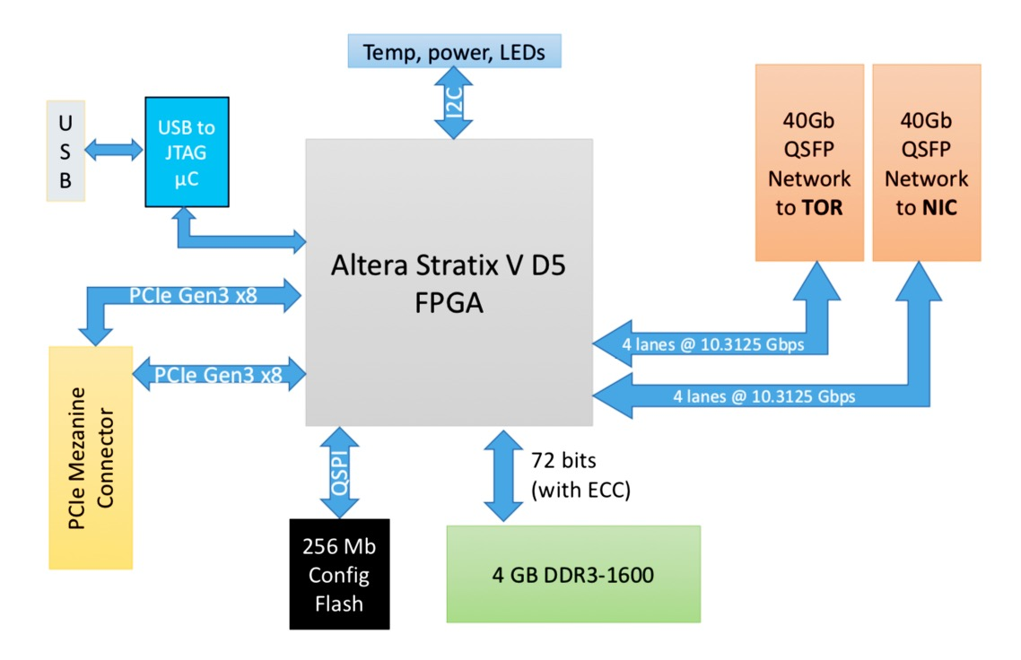
Microsoft Configurable Cloud

Slide 46
FPGAs for AI: Microsoft
Project Brainwave: a DL acceleration platform.
Announced at the 2017 Hot Chips Conference.
A DNN hardware engine synthesized onto FPGAs.
High performance, distributed system architecture
Compiler and runtime for low-friction deployment of trained models
Leverages Microsoft’s vast FPGA infrastructure
By attaching FPGAs directly to the datacenter network DNNs can be served as hardware microservices.

Slide 47
Hardware for AI : GPUs

Slide 48
Hardware for AI: GPUs
CPU
DOZENS OF CORES
GPU
THOUSANDS OF CORES

Slide 49
Hardware for AI: GPUs
Originally designed to process graphics, GPUs have become a popular DL workhorse.
Feature thousands of small, simple cores specialized for numeric, parallel computations.
Many transistors dedicated to computation.
GPUs excel at repeated similar instructions in parallel.
Optimized for parallel data throughput computation.
Major neural net breakthroughs since 2012 have been powered by GPU computations – performance has since increased >5x.
Once the data is in the GPU memory the bottlenecks are small.
NVIDIA is highly popular in GPUs

Slide 50
CPUs vs GPUs

Slide 51
CPUs vs GPUs
While GPUs are specialized processors, CPUs are still the main computation engines on most computers.
CPUs have dozens of cores compared to GPUs that have thousands of less powerful cores.
CPUs have fewer arithmetic logic units (ALUs) and a lower compute density than GPUs
CPUs are lower latency and have larger cache memory compared to GPUs

Slide 52
CPUs vs GPUs
While GPUs are specialized processors, CPUs are still the main computation engines on most computers.
GPUs are designed for parallel tasks and perform well when a single instruction is to be performed over a large amount of data.
GPUs have additional overhead when copying data from main memory is required so CPUs can be better when a large number of memory swaps are needed.
GPUs are not good for tasks that cannot be parallelized or when heavy processing on fewer data streams is needed. CPUs excel at serial tasks.
CPUs are easy to program – popular programming languages compile to machine code, to be run on CPU by default.

Slide 53
NVIDIA GPUs
NVIDIA‘s main business is in dedicated hardware for discrete graphics processors.
Several factors have made NVIDIA highly popular in this space.
CUDA* framework which lets developers write code in C++, Python*, and other popular languages that run optimized operations on the GPU.
Early incorporation of GPUs with cloud services, such as Amazon Web Services*.
For several years, NVIDIA facilitated ecosystem adoption by optimizing their libraries and abstracting the complexities of the GPU through SDKs, tools, and libraries.
*Other names and brands may be claimed as the property of others.

Slide 54
Custom Hardware for AI

Slide 55
Hardware for AI: General Purpose vs. Specialized
AI runs on both general purpose processors and on specialized hardware.
Specialized Hardware
Google
TPU*
Apple Neural Engine*
Intel®
Nervana™ NNP
Intel® Movidius™
*Other names and brands may be claimed as the property of others.

Slide 56
Google Tensor Processing Unit* (TPU)
Google’s TPU* is the first major example of a chip designed for AI.
Google’s first-gen TPU (2015) was designed specifically for fast inference.
Unlike a GPU, no capabilities for graphics tasks, such as rasterization or texture mapping.
Second-gen (2017) increased the precision available for computations, making this version usable for training as well.
*Other names and brands may be claimed as the property of others.

Slide 57
Apple Neural Engine*
Apple Neural Engine* system is on a chip designed for fast inference.
Apple Neural Engine shipped on late 2017 iPhones.
Separate from main CPU and GPU on iPhone.
Specifically designed for fast neural net inference, capable of 600 billion operations per second.
Highlighted importance of fast neural net inference to Apple’s ability to provide its desired user experience.
*Other names and brands may be claimed as the property of others.

Slide 58
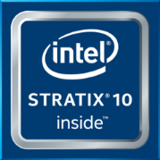
Processor Types
We’ve covered processors that span general purpose use to custom built solutions.
CPUs handle all workloads, serial and parallel.
GPUs for fast parallel processing for images, graphics, and highly parallel workloads.
Highly flexible and custom built solutions like FPGAs and Intel® NNP™
General
Custom

Slide 59
Learning Objectives Recap
In this lesson, we worked to:
Define “datacenter”, “gateway”, and ”edge” computing
Recall the key processor types for AI
Explain how Intel® hardware applies to AI
Describe Field Programmable Gate Arrays (FPGA)
Compare Central (CPU) and Graphic (GPU) processing units

Slide 60
Homework exercise

Slide 61
Get Access to Hardware
Sign up for Intel® AI DevCloud access
Understand the tools & libraries that are available to use via remote access
Sign up & receive access to start work on the Jupyter* notebooks from the Artificial Intelligence 501, Machine Learning 501, Deep Learning 501 or TensorFlow 501 student kits.
Learn more at https://software.intel.com/en-us/ai-academy/students/kits

Slide 62
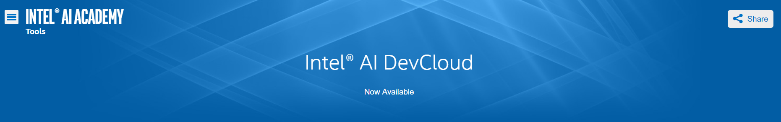
Intel® AI DevCloud™ Overview
Intel AI DevCloud™ is a server cluster consisting of Intel® Xeon® scalable processors.
Storage, compute needed for DL.
Pre-loaded with several Intel® optimized DL packages:
neon™, Theano*, TensorFlow*, Caffe*, Keras*.
Intel® Distribution for Python*.
*Other names and brands may be claimed as the property of others.
Notes:
Intel has been optimizing the popular AI frameworks for Intel Architecture and seeing dramatic speedup. This enables customers to select their favorite framework. We will enable more frameworks in the future with Intel Nervana Graph. Each of these frameworks have a varying degree of optimizations, so take a look at the roadmap for more details. Neon is Intel’s innovation framework that we will continue to support the state-of-the-art models.
https://software.intel.com/en-us/ai-academy/tools/devcloud

Slide 63
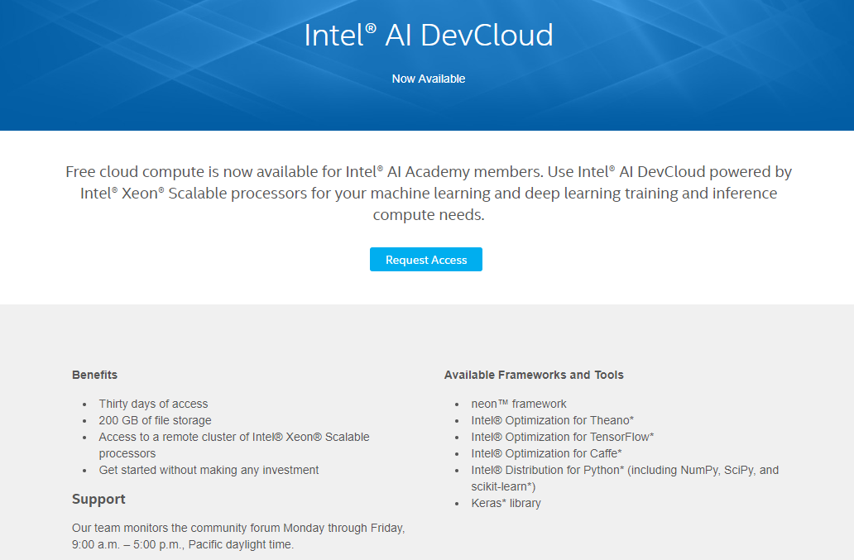
https://software.intel.com/en-us/ai-academy/tools/devcloud

Slide 64
Additional Intel® Courses

Slide 65
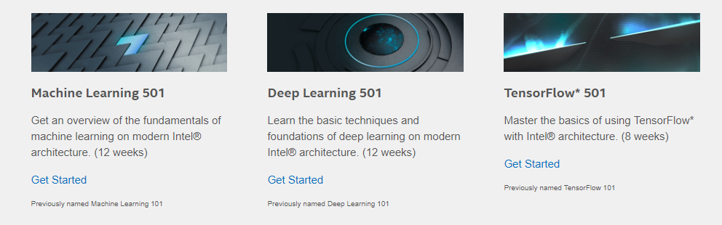
Other Resources: AI Student Kits
Intel® AI student kits includes courses on machine learning and deep learning.
All three contain concrete examples of implementing AI techniques.
Notes:
https://software.intel.com/en-us/ai-academy/students/kits

Slide 67
Configuration details (cont’d)
2S Intel® Xeon® processor E5-2697A v4 on Apache Spark™ with MKL2017 up to 18x performance increase compared to 2S E5-2697 v2 + F2JBLAS machine learning training
BASELINE: Intel® Xeon® Processor E5-2697 v2 (12 Cores, 2.7 GHz), 256GB memory, CentOS 6.6*, F2JBLAS: https://github.com/fommil/netlib-java, Relative performance 1.0
Intel® Xeon® processor E5-2697 v2 Apache* Spark* Cluster: 1-Master + 8-Workers, 10Gbit/sec Ethernet fabric, Each system with 2 Processors, Intel® Xeon® processor E5-2697 v2 (12 Cores, 2.7 GHz), Hyper-Threading Enabled, 256GB RAM per System, 1-240GB SSD OS Drive, 12-3TB HDDs Data Drives Per System, CentOS* 6.6, Linux 2.6.32-642.1.1.el6.x86_64, Intel® Intel® MKL 2017 build U1_20160808 , Cloudera Distribution for Hadoop (CDH) 5.7, Apache* Spark* 1.6.1 standalone, OMP_NUM_THREADS=1 set in CDH*, Total Java Heap Size of 200GB for Spark* Master and Workers, Relative performance up to 3.4x
Intel® Xeon® processor E5-2699 v3 Apache* Spark* Cluster: 1-Master + 8-Workers, 10Gbit/sec Ethernet fabric, Each system with 2 Processors, Intel® Xeon® processor E5-2699 v3 (18 Cores, 2.3 GHz), Hyper-Threading Enabled, 256GB RAM per System, 1-480GB SSD OS Drive, 12-4TB HDDs Data Drives Per System, CentOS* 7.0, Linux 3.10.0-229.el7.x86_64, Intel® Intel® MKL 2017 build U1_20160808 , Cloudera Distribution for Hadoop (CDH) 5.7, Apache* Spark* 1.6.1 standalone, OMP_NUM_THREADS=1 set in CDH*, Total Java Heap Size of 200GB for Spark* Master and Workers, Relative performance up to 8.8x
Intel® Xeon® processor E5-2697A v4 Apache* Spark* Cluster: 1-Master + 8-Workers, 10Gbit Ethernet/sec fabric, Each system with 2 Processors, Intel® Xeon® processor E5-2697A v4 (16 Cores, 2.6 GHz), Hyper-Threading Enabled, 256GB RAM per System, 1-800GB SSD OS Drive, 10-240GB SSDs Data Drives Per System, CentOS* 6.7, Linux 2.6.32-573.12.1.el6.x86_64, Intel® MKL 2017 build U1_20160808 , Cloudera Distribution for Hadoop (CDH) 5.7, Apache* Spark* 1.6.1 standalone, OMP_NUM_THREADS=1 set in CDH*, Total Java Heap Size of 200GB for Spark* Master and Workers, Relative performance up to 18x
Machine learning algorithm used for all configurations : Alternating Least Squares ALS Machine Learning Algorithm https://github.com/databricks/spark-perf
Intel® Xeon Phi™ Processor 7250 GoogleNet V1 Time-To-Train Scaling Efficiency up to 97% on 32 nodes
32 nodes of Intel® Xeon Phi™ processor 7250 (68 Cores, 1.4 GHz, 16GB MCDRAM: flat mode), 96GB DDR4 memory, Red Hat* Enterprise Linux 6.7, export OMP_NUM_THREADS=64 (the remaining 4 cores are used for driving communication) MKL 2017 Update 1, MPI: 2017.1.132, Endeavor KNL bin1 nodes, export I_MPI_FABRICS=tmi, export I_MPI_TMI_PROVIDER=psm2, Throughput is measured using “train” command. Data pre-partitioned across all nodes in the cluster before training. There is no data transferred over the fabric while training. Scaling efficiency computed as: (Single node performance / (N * Performance measured with N nodes))*100, where N = Number of nodes
Intel® Caffe: Intel internal version of Caffe
GoogLeNetV1: http://static.googleusercontent.com/media/research.google.com/en//pubs/archive/43022.pdf, batch size 1536
Intel® Xeon Phi ™ processor 7250 up to 400x performance increase with Intel Optimized Frameworks compared to baseline out of box performance
BASELINE: Caffe Out Of the Box, Intel® Xeon Phi™ processor 7250 (68 Cores, 1.4 GHz, 16GB MCDRAM: cache mode), 96GB memory, Centos 7.2 based on Red Hat* Enterprise Linux 7.2, BVLC-Caffe: https://github.com/BVLC/caffe, with OpenBLAS, Relative performance 1.0
NEW: Caffe: Intel® Xeon Phi™ processor 7250 (68 Cores, 1.4 GHz, 16GB MCDRAM: cache mode), 96GB memory, Centos 7.2 based on Red Hat* Enterprise Linux 7.2, Intel® Caffe: : https://github.com/intel/caffe based on BVLC Caffe as of Jul 16, 2016, MKL GOLD UPDATE1, Relative performance up to 400x
AlexNet used for both configuration as per https://papers.nips.cc/paper/4824-Large image database-classification-with-deep-convolutional-neural-networks.pdf, Batch Size: 256
Intel® Xeon Phi™ Processor 7250, 32 node cluster with Intel® Omni Path Fabric up to 97% GoogleNetV1 Time-To-Train Scaling Efficiency
Caffe: Intel® Xeon Phi™ processor 7250 (68 Cores, 1.4 GHz, 16GB MCDRAM: flat mode), 96GB DDR4 memory, Red Hat* Enterprise Linux 6.7, Intel® Caffe: https://github.com/intel/caffe, not publically available yet
export OMP_NUM_THREADS=64 (the remaining 4 cores are used for driving communication)
MKL 2017 Update 1, MPI: 2017.1.132, Endeavor KNL bin1 nodes, export I_MPI_FABRICS=tmi, export I_MPI_TMI_PROVIDER=psm2, Throughput is measured using “train” command. Split the images across nodes and copied locally on each node at the beginning of training. No IO happens over fabric while training.
GoogLeNetV1: http://static.googleusercontent.com/media/research.google.com/en//pubs/archive/43022.pdf, batch size 1536
Intel® Xeon Phi ™ processor Knights Mill up to 4x estimated performance improvement over Intel® Xeon Phi™ processor 7290
BASELINE: Intel® Xeon Phi™ Processor 7290 (16GB, 1.50 GHz, 72 core) with 192 GB Total Memory on Red Hat Enterprise Linux* 6.7 kernel 2.6.32-573 using MKL 11.3 Update 4, Relative performance 1.0
NEW: Intel® Xeon phi™ processor family – Knights Mill, Relative performance up to 4x
Intel® Arria 10 – 1150 FPGA energy efficiency on Caffe/AlexNet up to 25 img/s/w with FP16 at 297MHz
Vanilla AlexNet Classification Implementation as specified by http://www.cs.toronto.edu/~fritz/absps/imagenet.pdf, Training Parameters taken from Caffe open-source Framework are 224x224x3 Input, 1000x1 Output, FP16 with Shared Block-Exponents, All compute layers (incl. Fully Connected) done on the FPGA except for Softmax, Arria 10-1150 FPGA, -1 Speed Grade on Altera PCIe DevKit with x72 DDR4 @ 1333 MHz, Power measured through on-board power monitor (FPGA POWER ONLY), ACDS 16.1 Internal Builds + OpenCL SDK 16.1 Internal Build, Compute machine is an HP Z620 Workstation, Xeon E5-1660 at 3.3 GHz with 32GB RAM. The Xeon is not used for compute.
Knights Mill performance : Results have been estimated or simulated using internal Intel analysis or architecture simulation or modeling, and provided to you for informational purposes. Any differences in your system hardware, software or configuration may affect your actual performance.
Optimization Notice: Intel's compilers may or may not optimize to the same degree for non-Intel microprocessors for optimizations that are not unique to Intel microprocessors. These optimizations include SSE2, SSE3, and SSSE3 instruction sets and other optimizations. Intel does not guarantee the availability, functionality, or effectiveness of any optimization on microprocessors not manufactured by Intel. Microprocessor-dependent optimizations in this product are intended for use with Intel microprocessors. Certain optimizations not specific to Intel microarchitecture are reserved for Intel microprocessors. Please refer to the applicable product User and Reference Guides for more information regarding the specific instruction sets covered by this notice. Notice Revision #20110804
Software and workloads used in performance tests may have been optimized for performance only on Intel microprocessors. Performance tests, such as SYSmark and MobileMark, are measured using specific computer systems, components, software, operations and functions. Any change to any of those factors may cause the results to vary. You should consult other information and performance tests to assist you in fully evaluating your contemplated purchases, including the performance of that product when combined with other products. For more complete information visit: http://www.intel.com/performance Source: Intel measured everything except Knights Mill which is estimated as of November 2016

Slide 68
Configuration details (cont’d)
Optimization Notice: Intel's compilers may or may not optimize to the same degree for non-Intel microprocessors for optimizations that are not unique to Intel microprocessors. These optimizations include SSE2, SSE3, and SSSE3 instruction sets and other optimizations. Intel does not guarantee the availability, functionality, or effectiveness of any optimization on microprocessors not manufactured by Intel. Microprocessor-dependent optimizations in this product are intended for use with Intel microprocessors. Certain optimizations not specific to Intel microarchitecture are reserved for Intel microprocessors. Please refer to the applicable product User and Reference Guides for more information regarding the specific instruction sets covered by this notice. Notice Revision #20110804.
Results have been estimated or simulated using internal Intel analysis or architecture simulation or modeling, and provided to you for informational purposes. Any differences in your system hardware, software or configuration may affect your actual performance.
Software and workloads used in performance tests may have been optimized for performance only on Intel microprocessors.
Performance tests, such as SYSmark and MobileMark, are measured using specific computer systems, components, software, operations and functions. Any
change to any of those factors may cause the results to vary. You should consult other information and performance tests to assist you in fully evaluating your
contemplated purchases, including the performance of that product when combined with other products. For more complete information visit
http://www.intel.com/performance/datacenter. Tested by Intel as of 14 June 2016. Configurations:
Faster and more scalable than GPU claim based on Intel analysis and testing
Up to 2.3x faster training per system claim based on AlexNet* topology workload (batch size = 1024) using a large image database running 4-nodes Intel Xeon Phi processor 7250 (16 GB MCDRAM, 1.4 GHz, 68 Cores) in Intel® Server System LADMP2312KXXX41, 96GB DDR4-2400 MHz, quad cluster mode, MCDRAM flat memory mode, Red Hat Enterprise Linux* 6.7 (Santiago), 1.0 TB SATA drive WD1003FZEX-00MK2A0 System Disk, running Intel® Optimized DNN Framework (internal development version) training 1.33 million images in 10.5 hours compared to 1-node host with four NVIDIA “Maxwell” GPUs training 1.33 million images in 25 hours (source: http://www.slideshare.net/NVIDIA/gtc-2016-opening-keynote slide 32).
Up to 38% better scaling efficiency at 32-nodes claim based on GoogLeNet deep learning image classification training topology using a large image database comparing one node Intel Xeon Phi processor 7250 (16 GB MCDRAM, 1.4 GHz, 68 Cores) in Intel® Server System LADMP2312KXXX41, DDR4 96GB DDR4-2400 MHz, quad cluster mode, MCDRAM flat memory mode, Red Hat* Enterprise Linux 6.7, Intel® Optimized DNN Framework with 87% efficiency to unknown hosts running 32 each NVIDIA Tesla* K20 GPUs with a 62% efficiency (Source: http://arxiv.org/pdf/1511.00175v2.pdf showing FireCaffe* with 32 NVIDIA Tesla* K20s (Titan Supercomputer*) running GoogLeNet* at 20x speedup over Caffe* with 1 K20).
Up to 6 SP TFLOPS based on the Intel Xeon Phi processor peak theoretical single-precision performance is preliminary and based on current expectations of cores, clock frequency and floating point operations per cycle. FLOPS = cores x clock frequency x floating-point operations per second per cycle
Up to 3x faster single-threaded performance claim based on Intel estimates of Intel Xeon Phi processor 7290 vs. coprocessor 7120 running XYZ workload.
Up to 2.3x faster training per system claim based on AlexNet* topology workload (batch size = 1024) using a large image database running 4-nodes Intel Xeon Phi processor 7250 (16 GB MCDRAM, 1.4 GHz, 68 Cores) in Intel® Server System LADMP2312KXXX41, 96GB DDR4-2400 MHz, quad cluster mode, MCDRAM flat memory mode, Red Hat Enterprise Linux* 6.7 (Santiago), 1.0 TB SATA drive WD1003FZEX-00MK2A0 System Disk, running Intel® Optimized DNN Framework, Intel® Optimized Caffe (internal development version) training 1.33 billion images in 10.5 hours compared to 1-node host with four NVIDIA “Maxwell” GPUs training 1.33 billion images in 25 hours (source: http://www.slideshare.net/NVIDIA/gtc-2016-opening-keynote slide 32).
Up to 38% better scaling efficiency at 32-nodes claim based on GoogLeNet deep learning image classification training topology using a large image database comparing one node Intel Xeon Phi processor 7250 (16 GB MCDRAM, 1.4 GHz, 68 Cores) in Intel® Server System LADMP2312KXXX41, DDR4 96GB DDR4-2400 MHz, quad cluster mode, MCDRAM flat memory mode, Red Hat* Enterprise Linux 6.7, Intel® Optimized DNN Framework with 87% efficiency to unknown hosts running 32 each NVIDIA Tesla* K20 GPUs with a 62% efficiency (Source: http://arxiv.org/pdf/1511.00175v2.pdf showing FireCaffe* with 32 NVIDIA Tesla* K20s (Titan Supercomputer*) running GoogLeNet* at 20x speedup over Caffe* with 1 K20).
Up to 50x faster training on 128-node as compared to single-node based on AlexNet* topology workload (batch size = 1024) training time using a large image database running one node Intel Xeon Phi processor 7250 (16 GB MCDRAM, 1.4 GHz, 68 Cores) in Intel® Server System LADMP2312KXXX41, 96GB DDR4-2400 MHz, quad cluster mode, MCDRAM flat memory mode, Red Hat Enterprise Linux* 6.7 (Santiago), 1.0 TB SATA drive WD1003FZEX-00MK2A0 System Disk, running Intel® Optimized DNN Framework, training in 39.17 hours compared to 128-node identically configured with Intel® Omni-Path Host Fabric Interface Adapter 100 Series 1 Port PCIe x16 connectors training in 0.75 hours. Contact your Intel representative for more information on how to obtain the binary. For information on workload, see https://papers.nips.cc/paper/4824-Large image database-classification-with-deep-convolutional-neural-networks.pdf.
Up to 30x software optimization improvement claim based on customer CNN training workload running 2S Intel® Xeon® processor E5-2680 v3 running Berkeley Vision and Learning Center* (BVLC) Caffe + OpenBlas* library and then run tuned on the Intel® Optimized Caffe (internal development version) + Intel® Math Kernel Library (Intel® MKL).

Slide 69
Configuration details (cont’d)
Platform: 2S Intel® Xeon® Platinum 8180 CPU @ 2.50GHz (28 cores), HT disabled, turbo disabled, scaling governor set to “performance” via intel_pstate driver, 384GB DDR4-2666 ECC RAM. CentOS Linux release 7.3.1611 (Core), Linux kernel 3.10.0-514.10.2.el7.x86_64. SSD: Intel® SSD DC S3700 Series (800GB, 2.5in SATA 6Gb/s, 25nm, MLC).
Performance measured with: Environment variables: KMP_AFFINITY='granularity=fine, compact‘, OMP_NUM_THREADS=56, CPU Freq set with cpupower frequency-set -d 2.5G -u 3.8G -g performance
Deep Learning Frameworks:
Caffe: (http://github.com/intel/caffe/), revision f96b759f71b2281835f690af267158b82b150b5c. Inference measured with “caffe time --forward_only” command, training measured with “caffe time” command. For “ConvNet” topologies, dummy dataset was used. For other topologies, data was stored on local storage and cached in memory before training. Topology specs from https://github.com/intel/caffe/tree/master/models/intel_optimized_models (GoogLeNet, AlexNet, and ResNet-50), https://github.com/intel/caffe/tree/master/models/default_vgg_19 (VGG-19), and https://github.com/soumith/convnet-benchmarks/tree/master/caffe/imagenet_winners (ConvNet benchmarks; files were updated to use newer Caffe prototxt format but are functionally equivalent). Intel C++ compiler ver. 17.0.2 20170213, Intel MKL small libraries version 2018.0.20170425. Caffe run with “numactl -l“.
TensorFlow: (https://github.com/tensorflow/tensorflow), commit id 207203253b6f8ea5e938a512798429f91d5b4e7e. Performance numbers were obtained for three convnet benchmarks: alexnet, googlenetv1, vgg(https://github.com/soumith/convnet-benchmarks/tree/master/tensorflow) using dummy data. GCC 4.8.5, Intel MKL small libraries version 2018.0.20170425, interop parallelism threads set to 1 for alexnet, vgg benchmarks, 2 for googlenet benchmarks, intra op parallelism threads set to 56, data format used is NCHW, KMP_BLOCKTIME set to 1 for googlenet and vgg benchmarks, 30 for the alexnet benchmark. Inference measured with --caffe time -forward_only -engine MKL2017option, training measured with --forward_backward_only option.
MxNet: (https://github.com/dmlc/mxnet/), revision 5efd91a71f36fea483e882b0358c8d46b5a7aa20. Dummy data was used. Inference was measured with “benchmark_score.py”, training was measured with a modified version of benchmark_score.py which also runs backward propagation. Topology specs from https://github.com/dmlc/mxnet/tree/master/example/image-classification/symbols. GCC 4.8.5, Intel MKL small libraries version 2018.0.20170425.
Neon: ZP/MKL_CHWN branch commit id:52bd02acb947a2adabb8a227166a7da5d9123b6d. Dummy data was used. The main.py script was used for benchmarking , in mkl mode. ICC version used : 17.0.3 20170404, Intel MKL small libraries version 2018.0.20170425.

Slide 70
Configuration details (cont’d)
Platform: 2S Intel® Xeon® CPU E5-2697 v2 @ 2.70GHz (12 cores), HT enabled, turbo enabled, scaling governor set to “performance” via intel_pstate driver, 256GB DDR3-1600 ECC RAM. CentOS Linux release 7.3.1611 (Core), Linux kernel 3.10.0-514.21.1.el7.x86_64. SSD: Intel® SSD 520 Series 240GB, 2.5in SATA 6Gb/s, 25nm, MLC.
Performance measured with: Environment variables: KMP_AFFINITY='granularity=fine, compact,1,0‘, OMP_NUM_THREADS=24, CPU Freq set with cpupower frequency-set -d 2.7G -u 3.5G -g performance
Deep Learning Frameworks:
Caffe: (http://github.com/intel/caffe/), revision b0ef3236528a2c7d2988f249d347d5fdae831236. Inference measured with “caffe time --forward_only” command, training measured with “caffe time” command. For “ConvNet” topologies, dummy dataset was used. For other topologies, data was stored on local storage and cached in memory before training. Topology specs from https://github.com/intel/caffe/tree/master/models/intel_optimized_models (GoogLeNet, AlexNet, and ResNet-50), https://github.com/intel/caffe/tree/master/models/default_vgg_19 (VGG-19), and https://github.com/soumith/convnet-benchmarks/tree/master/caffe/imagenet_winners (ConvNet benchmarks; files were updated to use newer Caffe prototxt format but are functionally equivalent). GCC 4.8.5, Intel MKL small libraries version 2017.0.2.20170110.

Slide 71
Configuration details (cont’d)
Intel® Caffe: Intel internal version of Caffe
Intel® Arria 10 – 1150 FPGA energy efficiency on Caffe/AlexNet up to 25 img/s/w with FP16 at 297MHz
Vanilla AlexNet Classification Implementation as specified by http://www.cs.toronto.edu/~fritz/absps/imagenet.pdf, Training Parameters taken from Caffe open-source Framework are 224x224x3 Input, 1000x1 Output, FP16 with Shared Block-Exponents, All compute layers (incl. Fully Connected) done on the FPGA except for Softmax, Arria 10-1150 FPGA, -1 Speed Grade on Altera PCIe DevKit with x72 DDR4 @ 1333 MHz, Power measured through on-board power monitor
(FPGA POWER ONLY), ACDS 16.1 Internal Builds + OpenCL SDK 16.1 Internal Build, Compute machine is an HP Z620 Workstation, Xeon E5-1660 at 3.3 GHz with 32GB RAM. The Xeon is not used for compute.
Projected data comes from verified deterministic model of DLA IP implementation on FPGA
© 2017 Intel Corporation. Intel, the Intel logo, Altera, ARRIA, CYCLONE, ENPIRION, MAX, NIOS, QUARTUS and STRATIX words and logos are trademarks of Intel Corporation or its subsidiaries in the U.S. and/or other countries. Other marks and brands may be claimed as the property of others.
* Other marks and brands may be claimed as the property of others.
Intel Confidential

Slide 72
Configuration details (cont’d)
INFERENCE using FP32 Batch Size Caffe GoogleNet v1 256 AlexNet 256.
Software and workloads used in performance tests may have been optimized for performance only on Intel microprocessors. Performance tests, such as SYSmark and MobileMark, are measured using specific computer systems, components, software, operations and functions. Any change to any of those factors may cause the results to vary. You should consult other information and performance tests to assist you in fully evaluating your contemplated purchases, including the performance of that product when combined with other products. For more complete information visit http://www.intel.com/performance Source: Intel measured as of June 2017 Optimization Notice: Intel's compilers may or may not optimize to the same degree for non-Intel microprocessors for optimizations that are not unique to Intel microprocessors. These optimizations include SSE2, SSE3, and SSSE3 instruction sets and other optimizations. Intel does not guarantee the availability, functionality, or effectiveness of any optimization on microprocessors not manufactured by Intel. Microprocessor-dependent optimizations in this product are intended for use with Intel microprocessors. Certain optimizations not specific to Intel microarchitecture are reserved for Intel microprocessors. Please refer to the applicable product User and Reference Guides for more information regarding the specific instruction sets covered by this notice.
Configurations 40, 41:
Platform: 2S Intel® Xeon® Platinum 8180 CPU @ 2.50GHz (28 cores), HT disabled, turbo disabled, scaling governor set to “performance” via intel_pstate driver, 384GB DDR4-2666 ECC RAM. CentOS Linux release 7.3.1611 (Core), Linux kernel 3.10.0-514.10.2.el7.x86_64. SSD: Intel® SSD DC S3700 Series (800GB, 2.5in SATA 6Gb/s, 25nm, MLC). Performance measured with: Environment variables: KMP_AFFINITY='granularity=fine, compact‘, OMP_NUM_THREADS=56, CPU Freq set with cpupower frequency-set -d 2.5G -u 3.8G -g performance. Deep Learning Frameworks: Caffe: (http://github.com/intel/caffe/), revision f96b759f71b2281835f690af267158b82b150b5c. Inference measured with “caffe time --forward_only” command, training measured with “caffe time” command. For “ConvNet” topologies, dummy dataset was used. For other topologies, data was stored on local storage and cached in memory before training. Topology specs from https://github.com/intel/caffe/tree/master/models/intel_optimized_models (GoogLeNet, AlexNet, and ResNet-50), https://github.com/intel/caffe/tree/master/models/default_vgg_19 (VGG-19), and https://github.com/soumith/convnet-benchmarks/tree/master/caffe/imagenet_winners (ConvNet benchmarks; files were updated to use newer Caffe prototxt format but are functionally equivalent). Intel C++ compiler ver. 17.0.2 20170213, Intel MKL small libraries version 2018.0.20170425. Caffe run with “numactl -l“.
Platform: 2S Intel® Xeon® CPU E5-2699 v3 @ 2.30GHz (18 cores), HT enabled, turbo disabled, scaling governor set to “performance” via intel_pstate driver, 256GB DDR4-2133 ECC RAM. CentOS Linux release 7.3.1611 (Core), Linux kernel 3.10.0-514.el7.x86_64. OS drive: Seagate* Enterprise ST2000NX0253 2 TB 2.5" Internal Hard Drive. Performance measured with: Environment variables: KMP_AFFINITY='granularity=fine, compact,1,0‘, OMP_NUM_THREADS=36, CPU Freq set with cpupower frequency-set -d 2.3G -u 2.3G -g performance. Deep Learning Frameworks: Intel Caffe: (http://github.com/intel/caffe/), revision b0ef3236528a2c7d2988f249d347d5fdae831236. Inference measured with “caffe time --forward_only” command, training measured with “caffe time” command. For “ConvNet” topologies, dummy dataset was used. For other topologies, data was stored on local storage and cached in memory before training. Topology specs from https://github.com/intel/caffe/tree/master/models/intel_optimized_models (GoogLeNet, AlexNet, and ResNet-50), https://github.com/intel/caffe/tree/master/models/default_vgg_19 (VGG-19), and https://github.com/soumith/convnet-benchmarks/tree/master/caffe/imagenet_winners (ConvNet benchmarks; files were updated to use newer Caffe prototxt format but are functionally equivalent). GCC 4.8.5, MKLML version 2017.0.2.20170110. BVLC-Caffe: https://github.com/BVLC/caffe, Inference & Training measured with “caffe time” command. For “ConvNet” topologies, dummy dataset was used. For other topologies, data was st ored on local storage and cached in memory before training BVLC Caffe (http://github.com/BVLC/caffe), revision 91b09280f5233cafc62954c98ce8bc4c204e7475 (commit date 5/14/2017). BLAS: atlas ver. 3.10.1.

Slide 73
Configuration details (cont’d)
Intel® and SURFsara* Research Collaboration
MareNostrum4/BSC* Configuration Details
*MareNostrum4/Barcelona Supercomputing Center: https://www.bsc.es/
Compute Nodes: 2 sockets Intel® Xeon® Platinum 8160 CPU with 24 cores each @ 2.10GHz for a total of 48 cores per node, 2 Threads per core, L1d 32K; L1i cache 32K; L2 cache 1024K; L3 cache 33792K, 96 GB of DDR4, Intel® Omni-Path Host Fabric Interface, dual-rail. Software: Intel® MPI Library 2017 Update 4Intel® MPI Library 2019 Technical Preview OFI 1.5.0PSM2 w/ Multi-EP, 10 Gbit Ethernet, 200 GB local SSD, Red Hat* Enterprise Linux 6.7.
Intel® Caffe: Intel® version of Caffe; http://github.com/intel/caffe/, revision 8012927bf2bf70231cbc7ff55de0b1bc11de4a69.
Intel® MKL version: mklml_lnx_2018.0.20170425; Intel® MLSL version: l_mlsl_2017.1.016
Model: Topology specs from https://github.com/intel/caffe/tree/master/models/intel_optimized_models (ResNet-50) and modified for wide-RedNet-50. Batch size as stated in the performance chart
Time-To-Train: measured using “train” command. Data copied to memory on all nodes in the cluster before training. No input image data transferred over the fabric while training;
Performance measured with:
export OMP_NUM_THREADS=44 (the remaining 4 cores are used for driving communication), export I_MPI_FABRICS=tmi, export I_MPI_TMI_PROVIDER=psm2
OMP_NUM_THREADS=44 KMP_AFFINITY="proclist=[0-87],granularity=thread,explicit" KMP_HW_SUBSET=1t MLSL_NUM_SERVERS=4 mpiexec.hydra -PSM2 -l -n $SLURM_JOB_NUM_NODES -ppn 1 -f hosts2 -genv OMP_NUM_THREADS 44 -env KMP_AFFINITY "proclist=[0-87],granularity=thread,explicit" -env KMP_HW_SUBSET 1t -genv I_MPI_FABRICS tmi -genv I_MPI_HYDRA_BRANCH_COUNT $SLURM_JOB_NUM_NODES -genv I_MPI_HYDRA_PMI_CONNECT alltoall sh -c 'cat /ilsvrc12_train_lmdb_striped_64/data.mdb > /dev/null ; cat /ilsvrc12_val_lmdb_striped_64/data.mdb > /dev/null ; ulimit -u 8192 ; ulimit -a ; numactl -H ; /caffe/build/tools/caffe train --solver=/caffe/models/intel_optimized_models/multinode/resnet_50_256_nodes_8k_batch/solver_poly_quick_large.prototxt -engine "MKL2017"
SURFsara blog: https://blog.surf.nl/en/imagenet-1k-training-on-intel-xeon-phi-in-less-than-40-minutes/ ; Researchers: Valeriu Codreanu, Ph.D. (PI).; Damian Podareanu, MSc; SURFsara* & Vikram Saletore, Ph.D. (co-PI): Intel Corp.
*SURFsara B.V. is the Dutch national high-performance computing and e-Science support center. Amsterdam Science Park, Amsterdam, The Netherlands.
Config 2
Intel® HPC Developer Conference, Nov 11-12, 2017

Slide 74
Legal notices & disclaimers
This document contains information on products, services and/or processes in development. All information provided here is subject to change without notice. Contact your Intel representative to obtain the latest forecast, schedule, specifications and roadmaps.
Intel technologies’ features and benefits depend on system configuration and may require enabled hardware, software or service activation. Learn more at intel.com, or from the OEM or retailer. No computer system can be absolutely secure.
Tests document performance of components on a particular test, in specific systems. Differences in hardware, software, or configuration will affect actual performance. Consult other sources of information to evaluate performance as you consider your purchase. For more complete information about performance and benchmark results, visit http://www.intel.com/performance.
Cost reduction scenarios described are intended as examples of how a given Intel-based product, in the specified circumstances and configurations, may affect future costs and provide cost savings. Circumstances will vary. Intel does not guarantee any costs or cost reduction.
Statements in this document that refer to Intel’s plans and expectations for the quarter, the year, and the future, are forward-looking statements that involve a number of risks and uncertainties. A detailed discussion of the factors that could affect Intel’s results and plans is included in Intel’s SEC filings, including the annual report on Form 10-K.
The products described may contain design defects or errors known as errata which may cause the product to deviate from published specifications. Current characterized errata are available on request.
Performance estimates were obtained prior to implementation of recent software patches and firmware updates intended to address exploits referred to as "Spectre" and "Meltdown." Implementation of these updates may make these results inapplicable to your device or system.
No license (express or implied, by estoppel or otherwise) to any intellectual property rights is granted by this document.
Intel does not control or audit third-party benchmark data or the web sites referenced in this document. You should visit the referenced web site and confirm whether referenced data are accurate.
Intel, the Intel logo, Pentium, Celeron, Atom, Core, Xeon and others are trademarks of Intel Corporation in the U.S. and/or other countries. *Other names and brands may be claimed as the property of others.
© 2018 Intel Corporation.

